Slide 1
People to People
from striving to thriving
Inge Jenssen
Md Salman Oahed
UiA -
Paulina Buvinic
Frida Støveren
- AHO
Notes:
https://www.youtube.com/watch?v=25bwiSikRsI&t=27s

Slide 2
Refugee +
Refugee
Home
Refugee
Work
Company established in Risør
Refugee Home:
Their main goal is to simplify the settlement process by providing an online service matching private landlords with refugees in need of housing.
Notes:
Paulina

Slide 3
Refugee +
Refugee
Home
Refugee
Work
Refugee Work
Web based guide for job seekers to learn about topics in job searching: unwritten rules, how to write applications/cv, among other
Mentoring program, pairing with norwegian people who have previous experience
Notes:
Paulina

Slide 4
Project Challenge
How can we increase the employment rate of low educated refugees in the municipalities outside the cities?
Notes:
Paulina

Slide 5
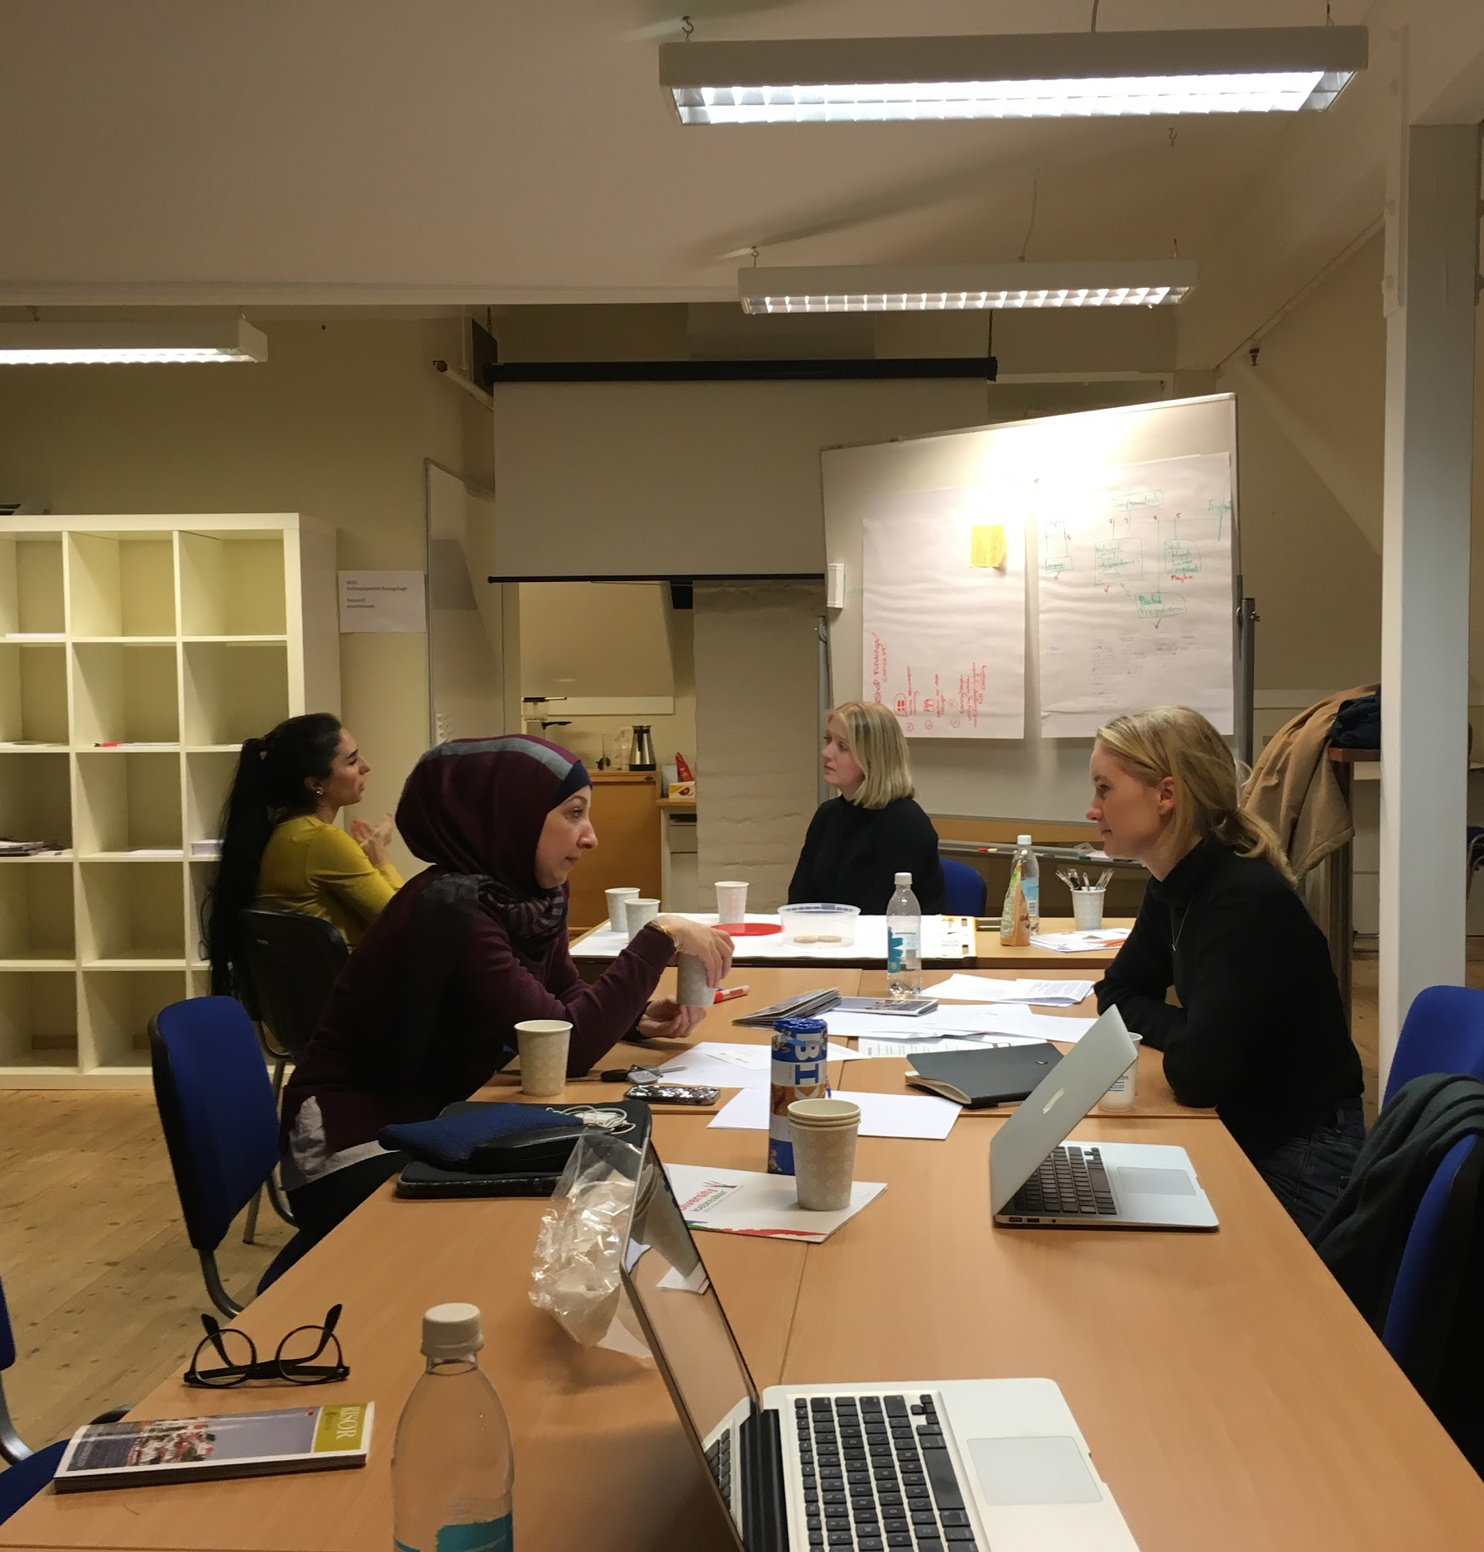
Research
Refugees living in Risør (#6)
NAV and Municipality
Risør Frivilligsentral
Local business
Notes:
Paulina

Slide 6
Main findings
What employers in Risør are looking for...
What refugees
want...
LANGUAGE
HAVE A FRIEND
“I´m not thinking of the future; I only want a job to get started.”
Refugee man, 28
FULL TIME JOB
NETWORK
Notes:
Paulina

Slide 7
Main findings
“I need someone to encourage me, or else I will stay home”
Refugee woman, 23
Risør activities:
Two Knitting club
Womans club
Reading to elderly and kids
Language café
...
“I don’t want to go alone to these activities”
Refugee woman, 23
Notes:
Paulina

Slide 8
Main findings
Risør activities:
Two Knitting club
Womans club
Reading to elderly and kids
Language café
...
“It’s about how they meet in the meeting spaces and how they interact… sometimes they just need a little push”
Frivilligsentral
It’s not about just creating the spaces
It’s about how they are design (interactions, incentives)
Notes:
Paulina

Slide 9
the need of the user
Practice the language
Build network
Feel valuable
Show their skills
Notes:
Paulina

Slide 10
Base proposal
Is using the word refugee for the programs the best one?
When do they stop being refugees and start being just a person?
Notes:
Paulina

Slide 11
Base proposal
Is using the word refugee for the programs the best one?
When do they stop being refugees and start being just a person?
Spirer
Notes:
Paulina

Slide 12
Proposal
Refugee
Home
Refugee
Work
People to People
Build network
Feel valuable
Show their skills
Notes:
Salman

Slide 13
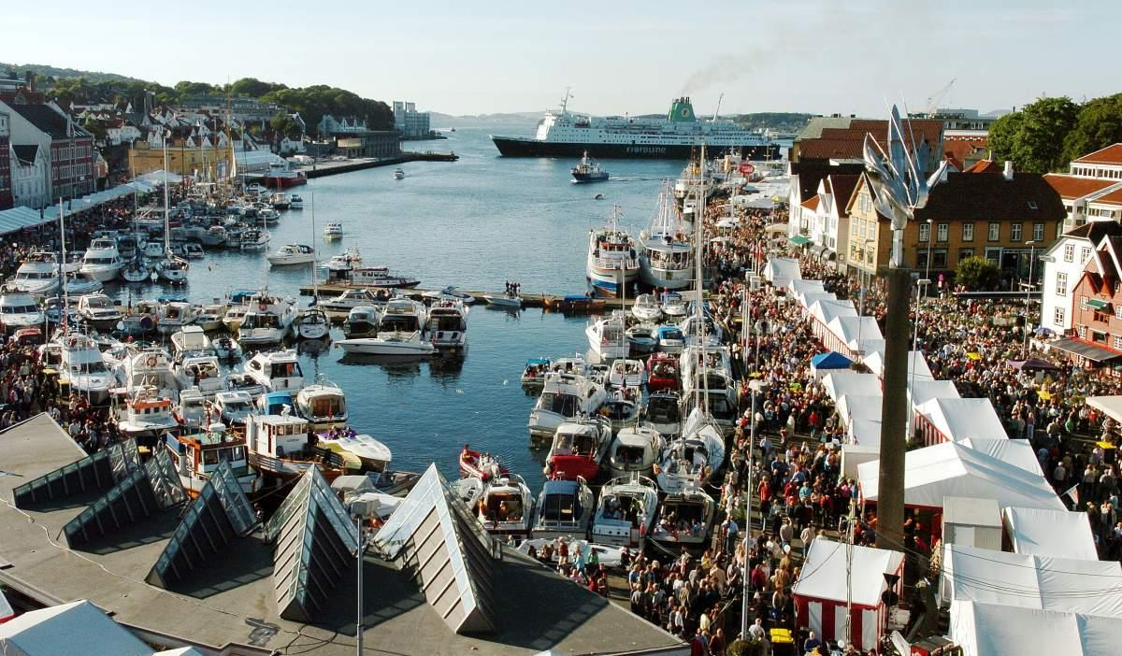
People to People
International
Food Festival
Notes:
Salman

Slide 14
Proposal
People to People
Vision:
Connect refugees with Risør by creating a common space that facilitate conversations making more accessible to develop network, show their skills and expertise to potential employers.
Notes:
Salman

Slide 15
Proposal
People to People
Strategy:
To realise our vision we want to plan and execute an International Food Festival with help from refugees as possible. To access also the reluctant ones we will create a co-operation with ViRK and NAV by offering Language Practice Work.
Initiate and facilitate the Festival
Access and involve as many refugees as possible and motivate them to participate in this festival
Learn from our mistakes and make it even better in a year!
Notes:
Salman

Slide 16
People to People
International Food Festival
15th May
First Day
16th May
Second Day
17 Mai!
3 months
Preparation to facilitate festival
Food Festival
Handicraft Expo
Innovative Café
End of the Festival
Notes:
Salman

Slide 17
How it works
The festival is in collaboration with VIRK, Frivilligsentralen, local schools
Create a profile
Arrive at municipality
VIRK
Language Practice Work
Planning of the festival
Public profile
People to People
Festival
People get assignments
Move into their home
Final meeting
of organizers
Get introduced with the program
Notes:
Frida More detailed..

Slide 18
How it works
The festival is in collaboration with VIRK, Frivilligsentralen, local schools
Create a profile
Arrive at municipality
VIRK
Language Practice Work
Planning of the festival
Public profile
People to People
Festival
People get assignments
Move into their home
Final meeting
of organizers
Get introduced with the program
Notes:
Frida

Slide 19
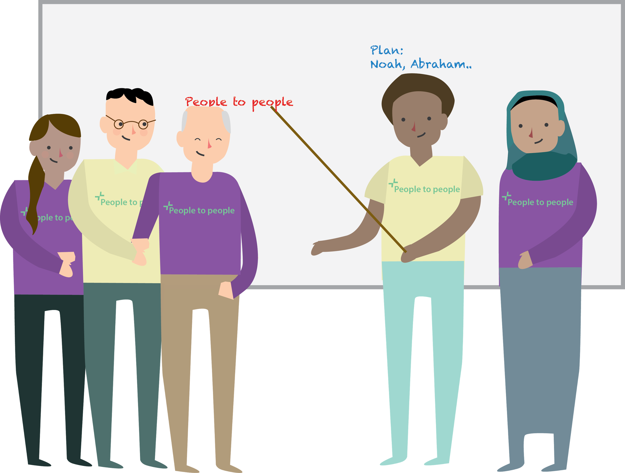
Feeling valuable
Notes:
Frida

Slide 20
How it works
The festival is in collaboration with VIRK, Frivilligsentralen, local schools
Create a profile
Arrive at municipality
VIRK
Language Practice Work
Planning of the festival
Public profile
People to People
Festival
People get assignments
Move into their home
Final meeting
of organizers
Get introduced with the program
Notes:
Frida

Slide 21
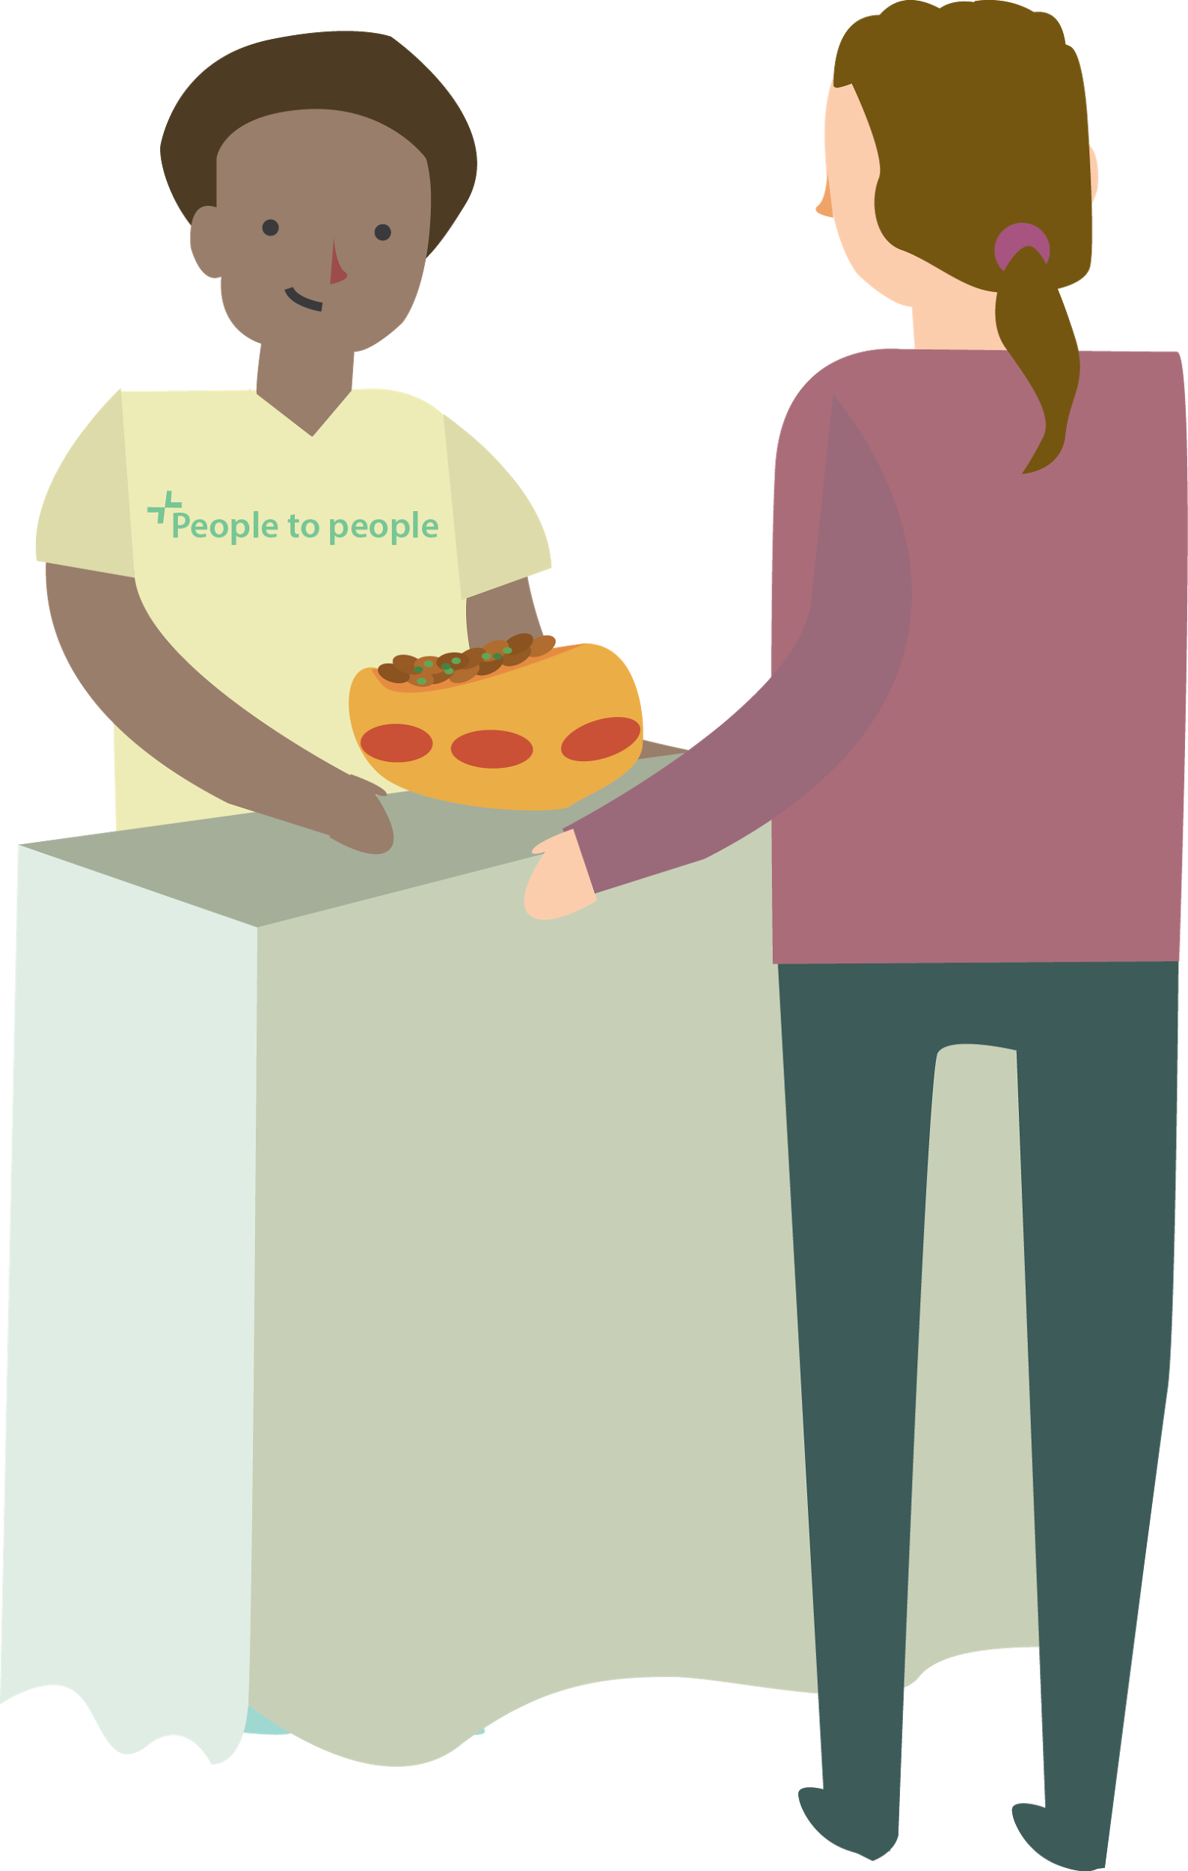
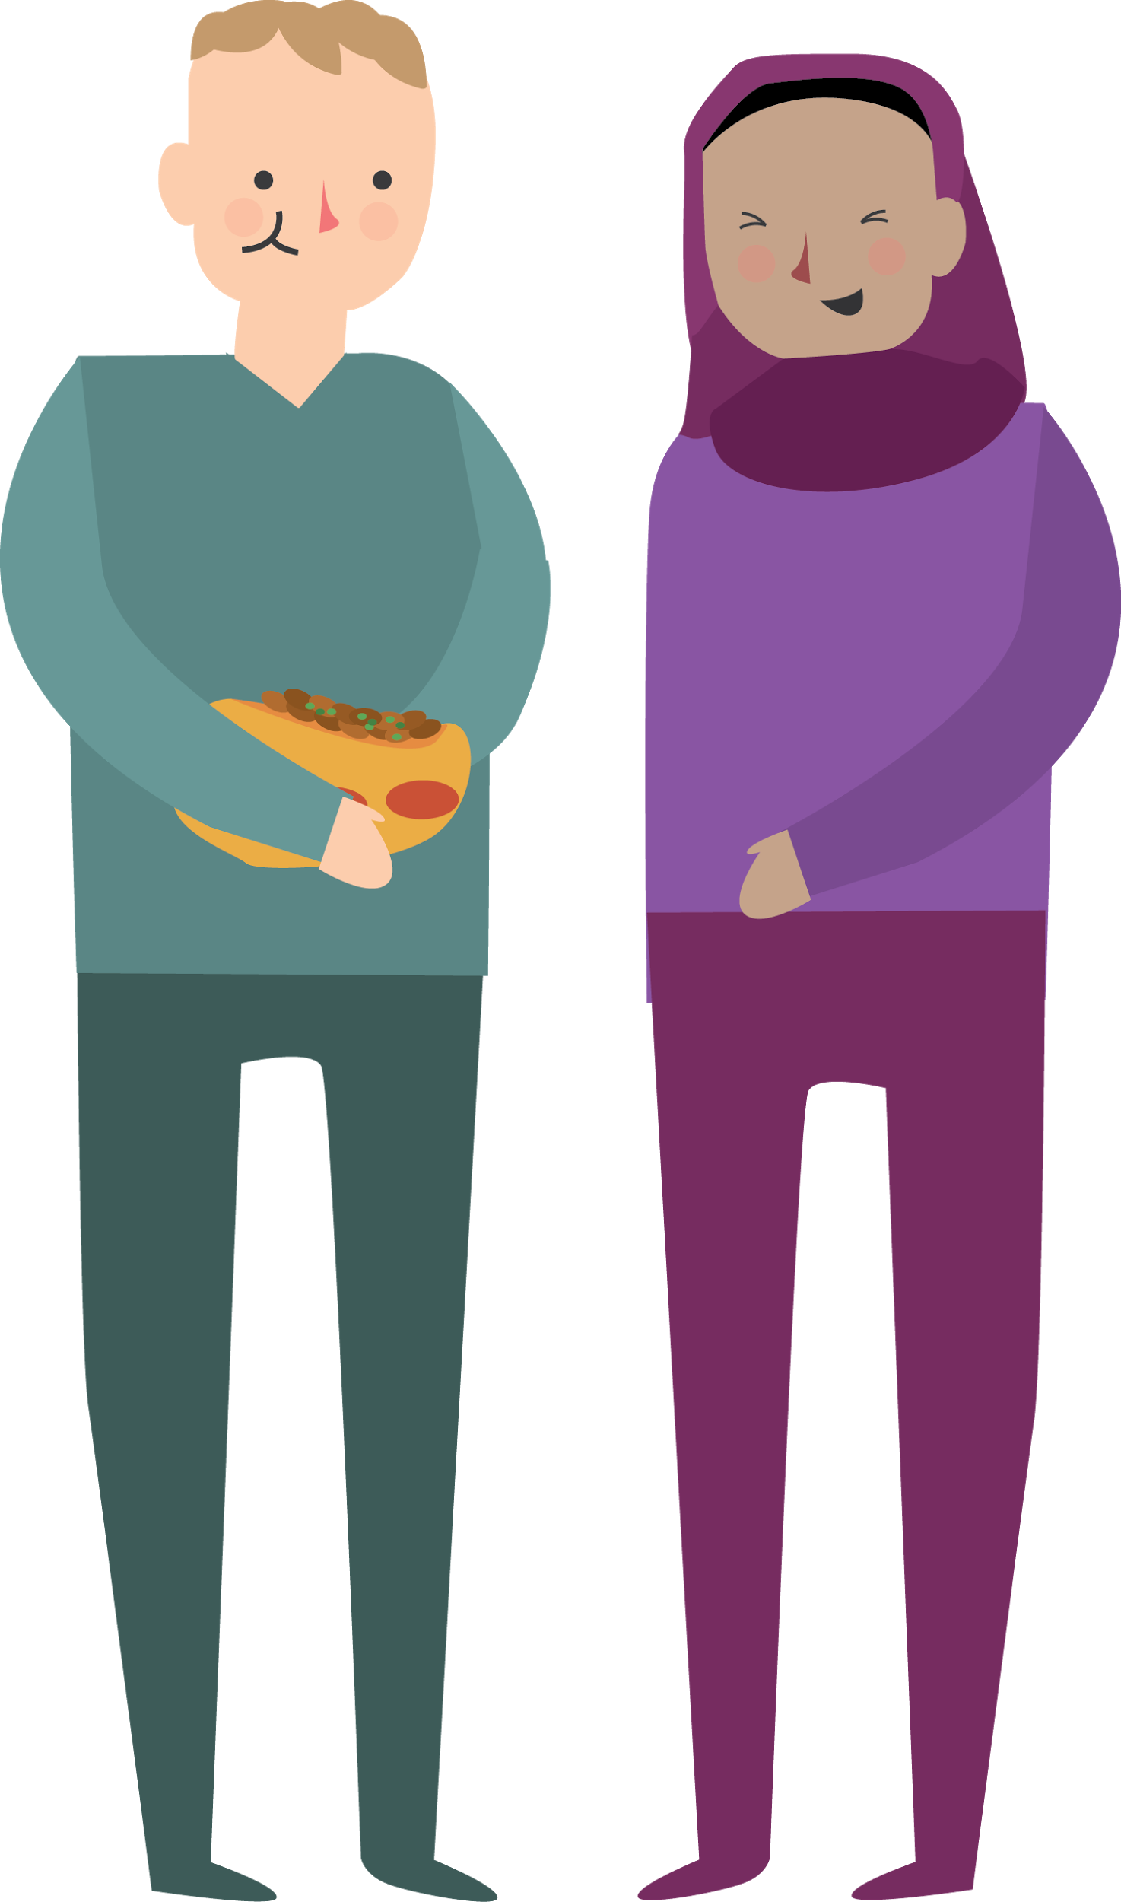
Showing their skills and build network
Notes:
Frida

Slide 22
How it works
The festival is in collaboration with VIRK, Frivilligsentralen, local schools
Create a profile
Arrive at municipality
VIRK
Language Practice Work
Planning of the festival
Public profile
People to People
Festival
People get assignments
Move into their home
Final meeting
of organizers
Get introduced with the program
Notes:
Frida

Slide 23
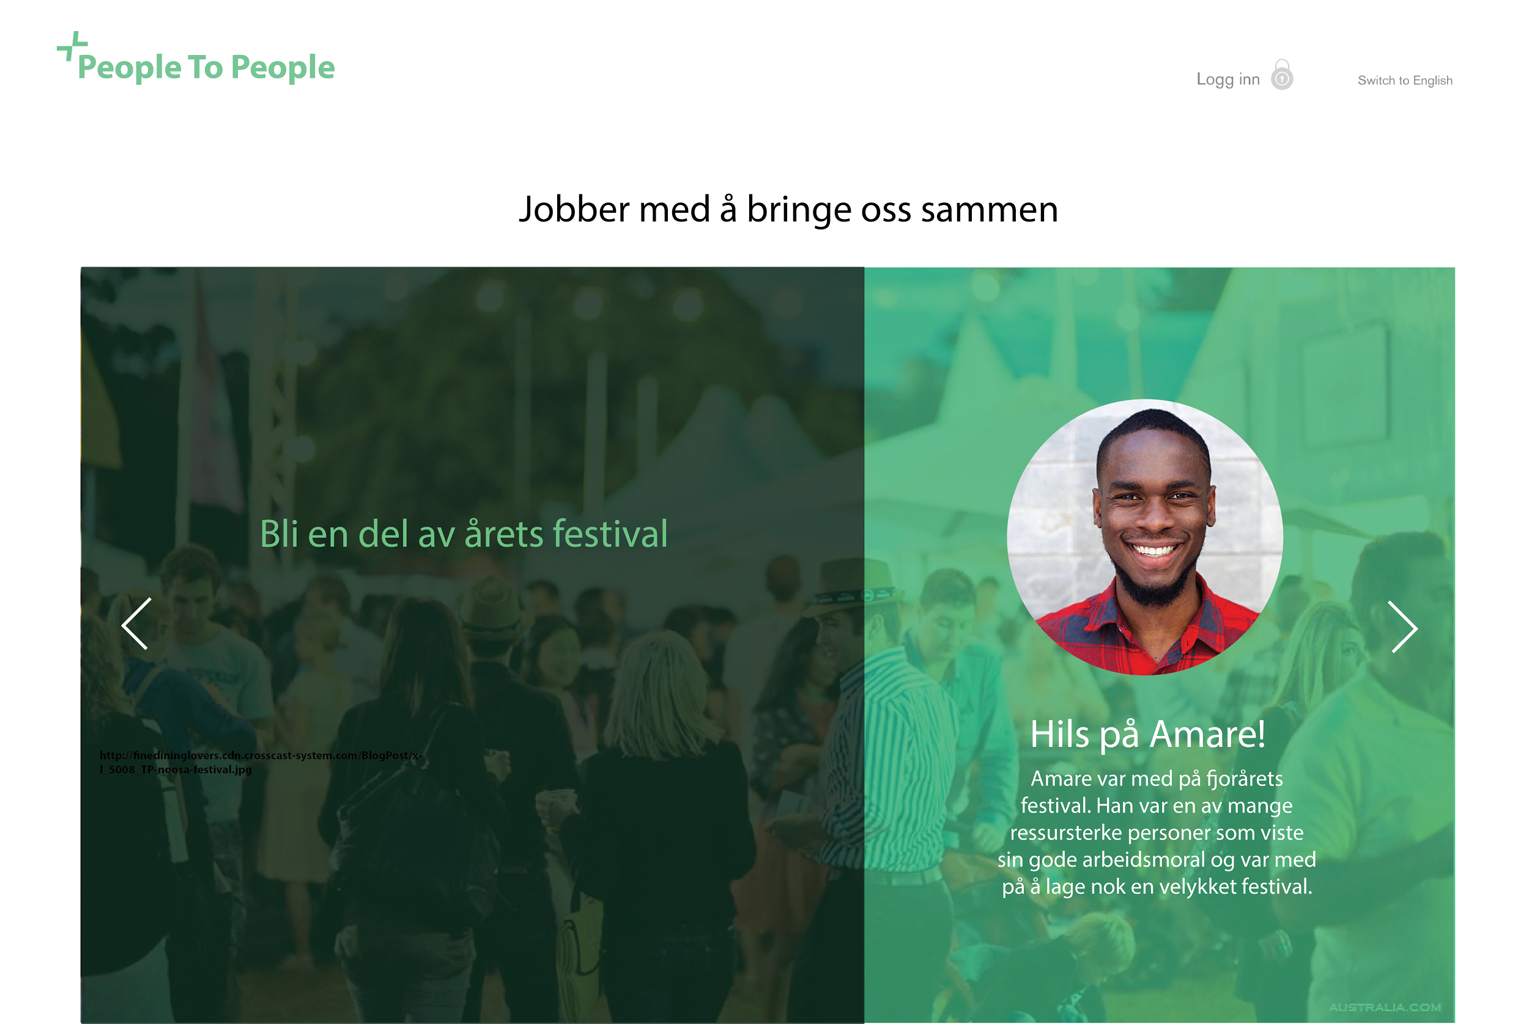
Notes:
Frida

Slide 24
Public Profile
Name
Skills & ambitions
Role in Festival: organizer, volunteer, participant (food, handicraft or idea).
People to People certification
Notes:
Frida: Micro-credentials

Slide 25
Improves chances of getting a job, helps you to contribute and feeling integrated to the society
Notes:
Frida: Micro-credentials

Slide 26
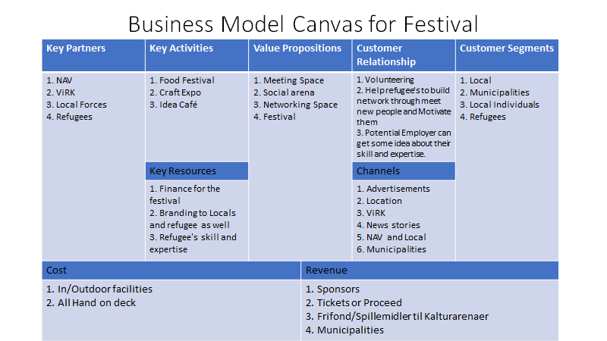
Notes:
Inge

Slide 27
People to People
Budgets & Funds
Venue/Location Cost
Marketing and Advertisement cost
Administrative cost
Audio/Visual Cost
Toilets
Internet
Security
Notes:
Inge

Slide 28
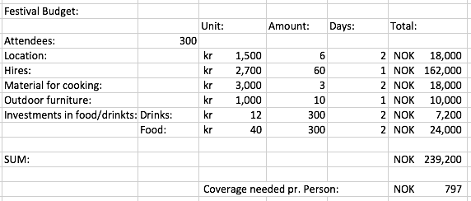
People to People
Cost
Notes:
Inge

Slide 29
People to People
Revenue
Notes:
Inge

Slide 30
Revenue - Cost = NOK-117.800
Worth the money!
Notes:
Inge

Slide 31
People to People
Notes:
Salman

Slide 32
Tusen Takk!
Thank you!
Inge Jenssen
Md Salman Oahed
UiA -
Paulina Buvinic
Frida Støveren
- AHO

